Slide 1
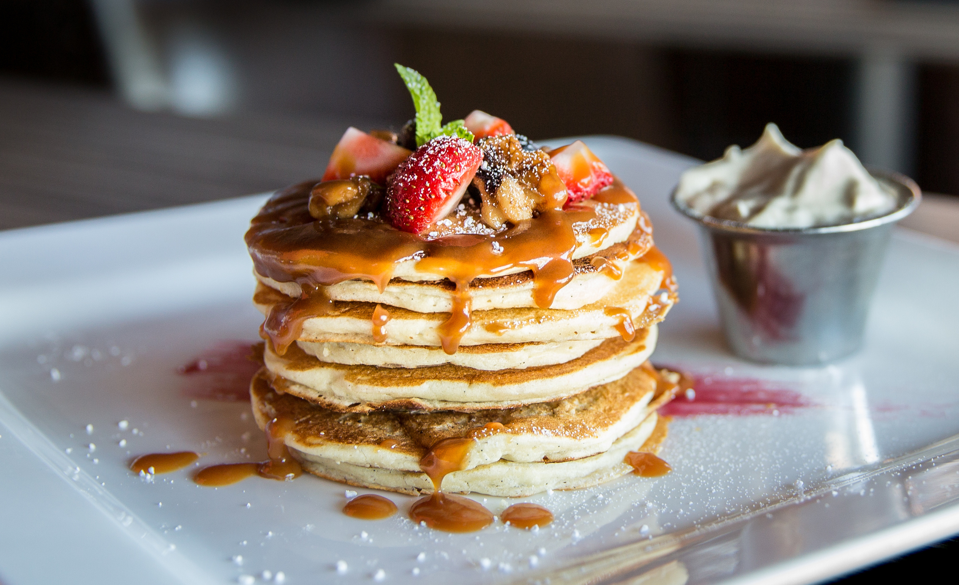
The PA Market - Catering Project
Guided By:
The PA market Team.
Prof. Khashayar Dehnad.
BIA 672-A
By:
Jash Shah
prerna Desai
venkat kurra
Aarthi Jeedipally

Slide 2

MEETING AGENDA
Introduction
Project Goal
Price Analysis - Corporate, Weddings, and Social events.
Sample packages - Bistro to Go, DiAnoia's Eatery, and, Common Plea Catering
Suggested Packages for The PA Marketing.
Strategies to differentiate your Catering Business in Pittsburgh’s market
Marketing
Building Strategic Connections: Universities and Corporate Clients in Pittsburgh
Customer Segmentation

Slide 3

The Pittsburgh catering industry is valued at $500 million, with a projected annual growth rate (CAGR) of 4.5% over the next five years.
Weddings and corporate events drive 65% of the market demand.
Evolving consumer preferences emphasize customization, premium menu options, and sustainable practices.
While established competitors exist, a clear gap exists for a high-end, European-inspired catering service that offers culinary excellence and exceptional customer service.
This market niche presents a strong opportunity for The PA Market to stand out and meet the growing demand for premium catering.
INTRODUCTION
PRODUCT
REACH

Slide 4

PROJECT GOAL
To create a high-end, European-inspired catering service that meets the demand for culinary excellence and exceptional customer service in Pittsburgh’s catering market, focusing on customization, premium menus, and sustainable practices. This project aims to position The PA Market as a competitive leader in corporate, wedding, and social event catering by identifying market opportunities and suggesting innovative strategies

Slide 5
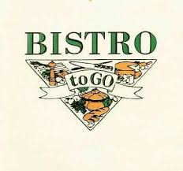


Competitors
Bistro to Go.
DiAnoia's Eatery.
Common Plea Catering.

Slide 6
Company Name | Website | Specialty | Contact Information
The Fluted Mushroom | flutedmushroom.com | Upscale and customizable catering | +1 412-381-1899
Black Radish Kitchen | blackradishkitchen.com | Farm-to-table, sustainable catering | +1 412-727-1664
All in Good Taste Productions | allingoodtasteproductions.com | Weddings and corporate events | +1 412-281-5140
The Commoner | thecommonerpgh.com | Boutique-style catering with creative menus | +1 412-230-4800
Savor Fresh Catering | savorfreshcatering.com | Affordable, high-quality catering | +1 412-567-7642

Slide 7

PRICE ANALYSIS - CORPORATE
Service | Common Plea Catering | Bistro to Go | DiAnoia’s Eatery
Breakfast | $15–$30 per person | $8–$12 per person | $12–$18 per person
Lunch (Boxed) | $20–$40 per person | $10–$20 per person | $15–$25 per person
Buffet | $30–$60 per person | $15–$30 per person | $25–$40 per person

Slide 8
PRICE ANALYSIS - WEDDINGS
Service | Common Plea Catering | Bistro to Go | DiAnoia’s Eatery
Cocktail Hour | $35–$50 per person | $10–$20 per person | $25–$40 per person
Dinner (Plated) | $100–$200 per person | $20–$40 per person | $30–$60 per person
Bar Packages | $25–$50 per person/hour | N/A | Add-on (varies)

Slide 9
PRICE ANALYSIS-SOCIAL EVENTS
Service | Common Plea Catering | Bistro to Go | DiAnoia’s Eatery
Small Plates | $25–$45 per person | $10–$20 per person | $20–$35 per person
Dessert Stations | $15–$30 per person | $10–$15 per person | $15–$25 per person

Slide 10
Sample Packages from Competitors
Catering Service | Wedding Package | Corporate Event Package | Holiday Party Package | Product Launch Package | Fundraiser Package | Buffet Package | Custom Package
Common Plea Catering | $50–$100 per person | $30–$60 per person | $35–$75 per person | $40–$80 per person | $45–$85 per person | $30–$60 per person | Varies based on request
Bistro to Go | N/A | $15–$30 per person | $20–$35 per person | $25–$40 per person | $20–$35 per person | $15–$30 per person | Varies
DiAnoia’s Eatery | $40–$80 per person | $25–$50 per person | $30–$60 per person | $35–$60 per person | $30–$50 per person | $25–$40 per person | Varies based

Slide 11
Suggested Packages for The PA Market
Event Type | Service | Proposed Price (per person) | Comments
 | Breakfast Options | $12–$25 | Affordable pricing with options like pastries and coffee.
Corporate Events | Lunch Options | $18–$35 | Includes boxed lunches or hot buffet options.
 | Buffet Options | $25–$50 | Flexible pricing for protein, sides, and dessert options.

Slide 12
Suggested Packages for The PA Market
Weddings
Cocktail Hour | $30–$45 | Competitive pricing with unique, customizable packages.
Plated Dinner | $90–$180 | Includes premium options like surf & turf.
Bar Packages | $20–$45 per hour | Add value with complimentary mocktail options.

Slide 13
Suggested Packages for The PA Market
Social Events | Small Plates & Tapas | $20–$40 | Trendy items with fresh, high-quality ingredients.
 | Dessert Stations | $12–$25 | Instagram-worthy dessert options.
Holiday Parties | Buffet-Style | $35–$60 | Seasonal themes and dishes to attract holiday clients.
 | Cocktail Hour | $25–$45 | Unique holiday hors d’oeuvres and drinks.

Slide 14
Marketing Stratergies
Targeted Advertising
Customer Referral Programs
Seasonal Promotions
Email Marketing
Event Sponsorships
Partnership Marketing
Video Marketing
User-Generated Content
Pop-Up Tastings
Loyalty Programs

Slide 15
Strategies to differentiate your Catering Business in Pittsburgh’s market
Unique selling Proposition(USP)
Innovative Service models
Affordable Luxury
Sustainable and ethical practices
Technology and convinience
Unique event Pairings
Flexible offerings
Impeccable Customer experience
Exclusive Add-ons

Slide 16
SWOT ANALYSIS STRENGTHS
Expertise in Corporate Catering: Specializing in IT and other industry sectors.
Customizable Menus: High-quality, tailored to meet client preferences and dietary needs.
Competitive Pricing: Transparent pricing structure that offers value without compromising quality.
Positive Reputation: Established trust and a growing client base, reflecting high customer satisfaction.
Skilled Team: Experienced professionals who ensure consistent service quality at every event

Slide 17
WEAKNESS
Limited Geographic Reach: Restricts market penetration and growth potential in broader areas
Revenue Dependence: Heavy reliance on the IT sector for a significant portion of revenue.
Underutilized Digital Marketing: Limited digital marketing strategy use impacts brand visibility.
Weak Logistics Network: Challenges in scaling operations efficiently to meet growing demand.
Low Brand Recognition: Limited recognition outside niche markets, reducing broader appeal.

Slide 18
Opportunities
Expansion into New Sectors: Tap into the healthcare, education, and finance industries for wider market reach.
Digital Marketing: Leverage digital marketing to boost visibility and improve customer engagement.
Strategic Partnerships: Collaborate with tech firms to offer exclusive deals and expand reach.
Rising Demand for Healthy & Sustainable Meals: Cater to the increasing consumer preference for health-conscious, sustainable, and inclusive meal options.
AI-Driven Personalization: Use AI to enhance customer satisfaction through tailored experiences.
Meal Delivery Demand: Capitalize on the growing need for meal delivery services driven by remote and hybrid work models.

Slide 19
THREATS
Intense Competition: Strong competition from established players in the catering industry.
Economic Downturns: Potential impacts on corporate spending, affecting event budgets.
Changing IT Trends: Fewer on-site events due to remote or hybrid work models in the IT sector.
Supply Chain Disruptions: Rising costs and potential delays due to supply chain issues.
New Competitors: Emerging competitors with aggressive pricing strategies that could affect market share.

Slide 20
STRATEGIES AND BRAND POSITIONING
Strategies for Revenue and Product Placement
Creating Revenue:
Especially with the IT and financial sectors, create long-term corporate catering agreements that incorporate volume discounts and loyalty programs.
Increase brand awareness by offering tiered packages catering to various business events.
Provide business workplaces with weekly or monthly food planning through subscription services.
To improve operational efficiency and menu customization, implement AI-powered personalization.

Slide 21
Positioning of the Product:
Target Market: If you're looking for upscale, hassle-free catering services, concentrate on IT companies and banks.
Our unique offerings include innovative culinary workshops for team building and customized event packages.
Value Proposition: Provide a stress-free client experience, upscale meal selections, and expert, dependable catering services.
To stand out in a crowded market, differentiate yourself by focusing on theme-aligned, personalized meals and first-rate service.
Engagement Techniques
To foster customer loyalty and relationships, use targeted email marketing directed at HR departments and office managers in important industries.
Increase exposure and interaction among professional audiences by utilizing social media with customized content and advertisements.

Slide 22
Operational Priority:
Adopt digital marketing and establish strategic alliances to increase market penetration and geographic reach.
In catering offerings, meet the main customer criteria for sustainability, quality, and personalization.
Investigate new prospects by utilizing emerging trends such as sustainable and healthful food options and allowing for remote and hybrid work environments.
The purpose of these slides is to give a concise summary of The PA Market's strategic revenue efforts, competitive positioning, engagement strategies, and long-term operating objectives.

Slide 23
Building Strategic Connections:
Universities in Pittsburgh
University Name | Website | Key Departments to Contact | Phone Number
University of Pittsburgh | www.pitt.edu | Event Services, Student Affairs, Catering Coordinators | +1 412-624-4141
Carnegie Mellon University | www.cmu.edu | Campus Dining Services, Fraternity/Sorority Organizations, Career Services | +1 412-268-2000
Duquesne University | www.duq.edu | Alumni Relations, Office of Special Events | +1 412-396-6000

Slide 24
Building Strategic Connections:
Corporates in Pittsburgh
Bayer | bayer.com | Conferences, Corporate events, employee Events. | +1 412-717-2000
Allegheny Technologies | atimetals.com | Corporate event management, Employee programs | +1 412-394-2800
EQT Corporation | eqt.com | Corporate events, Community engagement, Conferences | +1 412-395-3000
Federated Investors | federatedinvestors.com | Conferences, Business meetings, Employee events | +1 412-288-1900
Mylan | mylan.com | Corporate events, Conferences, Special events | +1 724-514-1800

Slide 25
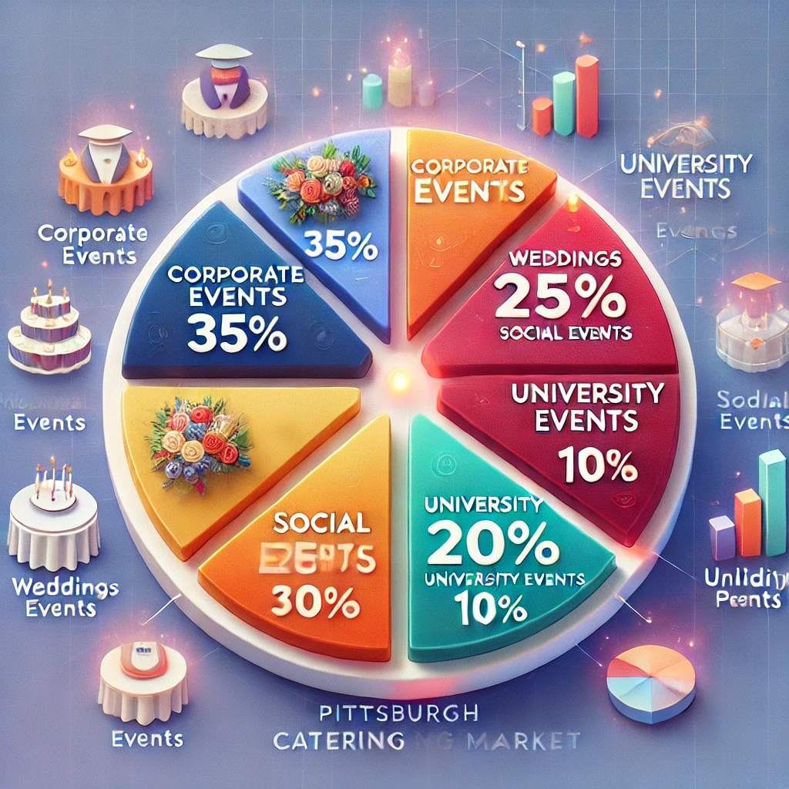
Customer Segmentation for PA Market.
Corporate Events dominate the market, with the highest share. This segment is crucial for consistent business and larger-scale catering operations.
Weddings are a highly lucrative segment, providing opportunities for premium pricing and specialized services.
Social Events and Holiday Parties are important for seasonal business, but they require flexibility in menu offerings to attract a diverse clientele.
University Events provide opportunities for catering services at a more affordable price point but are important for gaining regular, repeat business.

Slide 26
Thank You
for your attention

